Slide 1
B-Tree

Slide 2
B Tree
A B-tree of order m is an m-way tree (i.e., a tree where each node may have up to m children) in which:
the number of keys in each non-leaf node is one less than the number of its children and these keys partition the keys in the children in the fashion of a search tree
all leaves are on the same level
all non-leaf nodes except the root have at least m / 2 children
the root is either a leaf node, or it has from two to m children
a leaf node contains no more than m – 1 keys

Slide 3
Operations
B-Tree of order 4
  Each node has at most 4 pointers and 3 keys, and at least 2 pointers and 1 key.
Insert: 5, 3, 21, 9, 1, 13, 2, 7, 10, 12, 4, 8

Slide 4
Insert 5, 3, 21
* 5 *
a
* 3 * 5 *
a
* 3 * 5 * 21 *
a

Slide 5
Insert 9
* 9 *
a
b
c
* 3 * 5 *
* 21 *
Node a splits creating 2 children: b and c

Slide 6
Insert 1, 13
* 9 *
a
b
c
* 1 * 3 * 5 *
* 13 * 21 *
Nodes b and c have room to insert more elements

Slide 7
Insert 2
* 3 * 9 *
a
b
d
c
* 1 * 2 *
* 5 *
* 13 * 21 *
Node b has no more room, so it splits creating node d.

Slide 8
Insert 7, 10
* 3 * 9 *
a
b
d
c
* 1 * 2 *
* 5 * 7 *
* 10 * 13 * 21 *
Nodes d and c have room to add more elements

Slide 9
Insert 12
* 3 * 9 * 13 *
a
b
d
c
e
* 1 * 2 *
* 5 * 7 *
* 10 * 12 *
* 21 *
Nodes c must split into nodes c and e

Slide 10
Insert 4
a
* 3 * 9 * 13 *
b
d
c
e
* 1 * 2 *
* 4 * 5 * 7 *
* 10 * 12 *
* 21 *
Node d has room for another element

Slide 11
Insert 8
a
* 9 *
f
g
* 3 * 7 *
* 13 *
b
d
h
c
e
* 1 * 2 *
* 4 * 5 *
* 8 *
* 10 * 12 *
* 21 *

Slide 12
Create a B-tree of order 5 with keys 10, 20, 50, 60, 40, 80, 100, 70, 130, 90, 30, 120, 140, 160
Construct a B-tree of order 5 and keys arrive in the following order:1, 12, 8, 2, 25, 5, 14, 28, 17, 7, 52, 16, 48, 68, 3, 26, 29, 53, 55, 45.

Slide 13
Solution of Ques 2.
17
3
8
28
48
1
2
6
7
12
14
16
25
26
29
45
52
53
55
68

Slide 14
What is a B+ Tree?
A variation of B trees in which
  internal nodes contain only search keys (no data)
  Leaf nodes contain pointers to data records
  Data records are in sorted order by the search key
  All leaves are at the same depth
Notes:
The properties of B-Trees (and the trees themselves) are a bit more complex than previous structures we’ve looked at.
Here’s a big, gnarly list; we’ll go one step at a time.
The maximum branching factor, as we said, is M (tunable for a given tree).
The root has between 2 and M children or at most L keys.
(L is another parameter)
These restrictions will be different for the root than for other nodes.

Slide 15
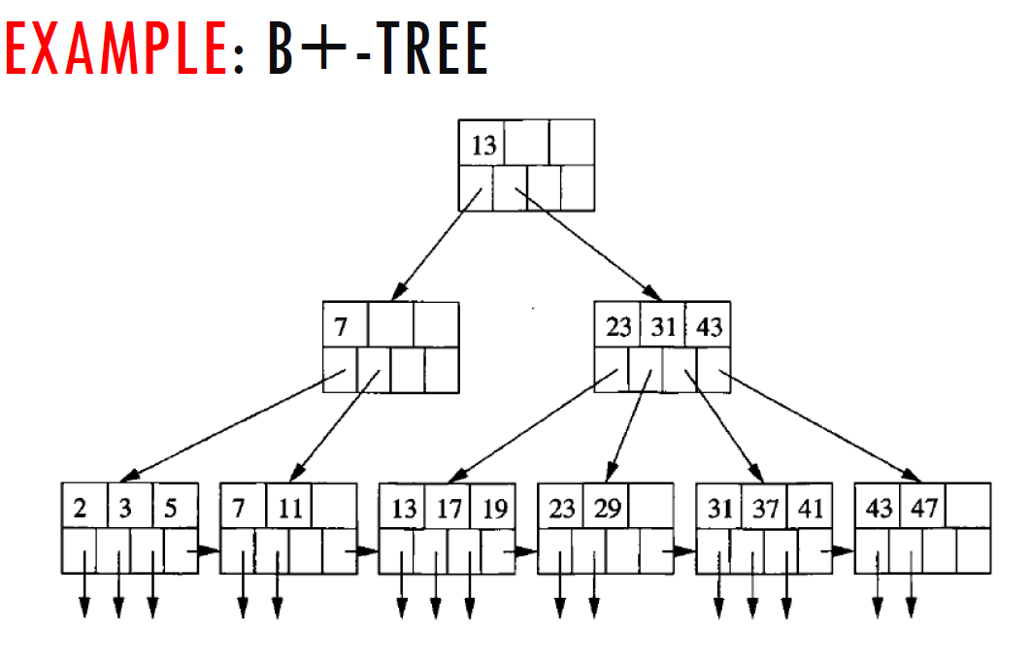


Slide 16
